Slide 1
Unit-3
Multiple View Geometry

Slide 2
This chapter will show you
how to handle multiple views and how to use the geometric relationships between them
to recover camera positions and 3D structure. With images taken at different view points,
it is possible to compute 3D scene points as well as camera locations from feature matches

Slide 3

Epipolar Geometry
geometric relationships are described by epipolar geometry
Without any prior knowledge of the cameras, there is an inherent ambiguity in that a 3Dpoint, X, transformed with an arbitrary (4 × 4) homography H as HX will have the same image point in a camera as the original point in the camera P.
Expressed with the camera equation

Slide 4

A good choice is to set the origin and coordinate axis to align with the first camera so that
K1 and K2 are the calibration matrices
R is the rotation of the second camera
t is the translation of the second camera.
Using these camera matrices, one can derive a condition for the projection of a point X to image points x1 and x2 (with P1 and P2, respectively).

Slide 5


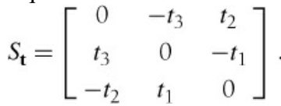
The following equation must be satisfied: Equation 5-1.
where
and the matrix St is the skew symmetric matrix Equation 5-2.
Equation (Equation 5-1) is called the epipolar constraint. The matrix F in the epipolar constraint is called the fundamental matrix

Slide 6
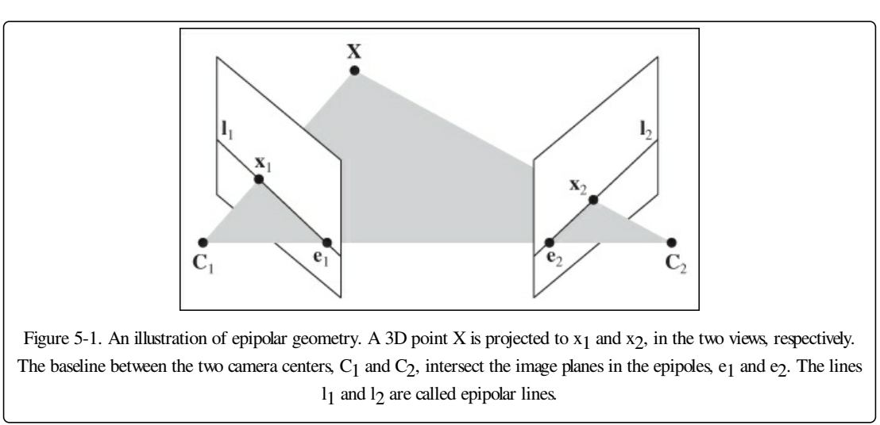

Slide 7
Computing with Cameras and 3D Structure
Here we briefly explain the tools we need for computing with cameras and 3D structure
Triangulation Given known camera matrices, a set of point correspondences can be triangulated to recover the 3D positions of these points

Slide 8
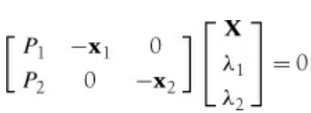
For two views with camera matrices P1 and P2, each with a projection x1 and x2 of the same 3D point X the camera equation gives the relation

Slide 9
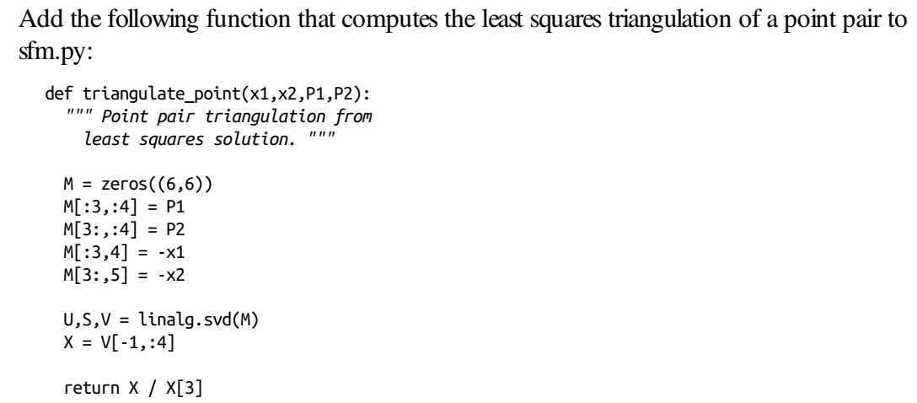

Slide 10
Computing the Camera Matrix from 3D Points
With known 3D points and their image projections, the camera matrix, P, can be computed using a direct linear transform approach.
This is essentially the inverse problem to triangulation and is sometimes called camera resectioning

Slide 11
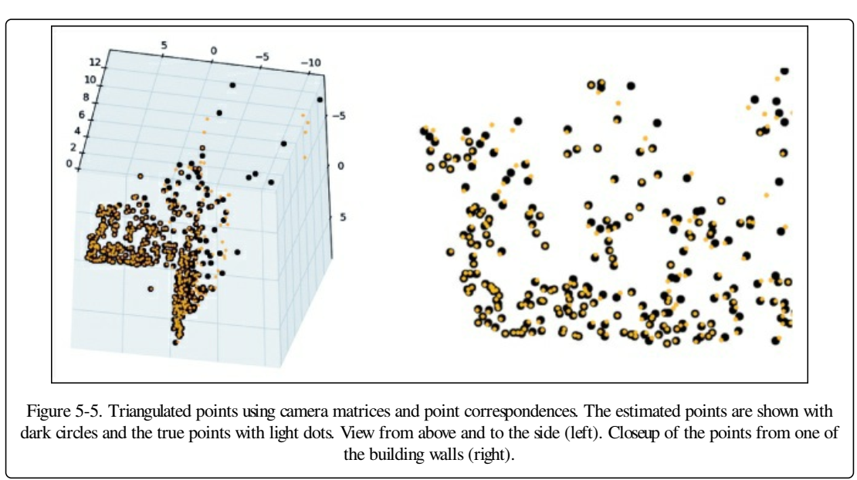

Slide 12
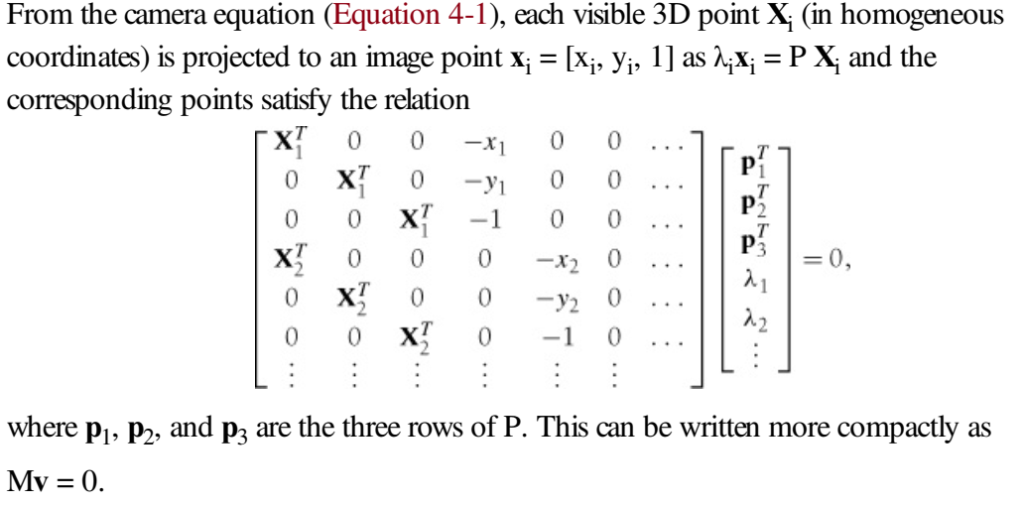

Slide 13
Multiple View Reconstruction
Computing a 3D reconstruction like this is usually referred to as structure from motion (SfM) since the motion of a camera (or cameras) gives you 3D structure.
Assuming the camera has been calibrated, the steps are as follows:
1. Detect feature points and match them between the two images.
2. Compute the fundamental matrix from the matches.
3. Compute the camera matrices from the fundamental matrix.
4. Triangulate the 3D points

Slide 14
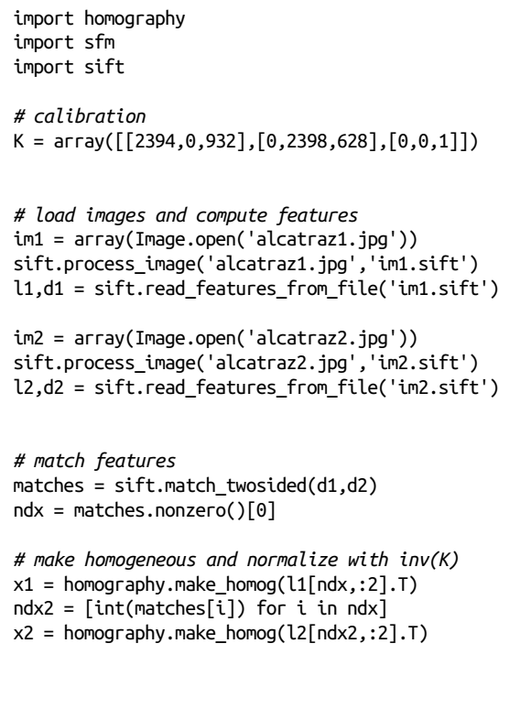
3D Reconstruction Example

Slide 15
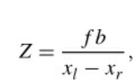
Stereo Images
A special case of multi-view imaging is stereo vision (or stereo imaging), where two cameras are observing the same scene with only a horizontal (sideways) displacement between the cameras
Once a corresponding point is found, its depth (Z coordinate)can be computed directly from the horizontal displacement as it is inversely proportional to the displacement,
where f is the rectified image focal length
b the distance between the camera centers, and
xl and xr the x-coordinate of the corresponding point in the left and right image.
The distance separating the camera centers is called the baseline.

Slide 16
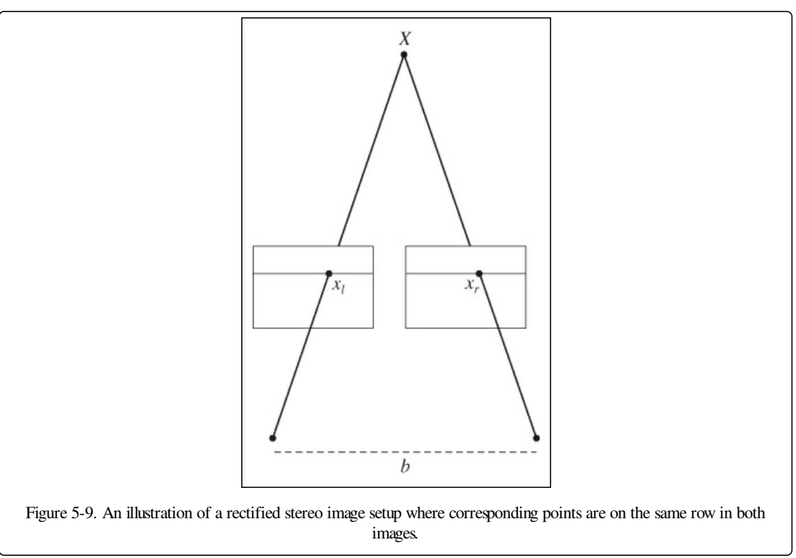

Slide 17
Clustering Images
Clustering can be used for recognition, for dividing data sets of images, and for organization and navigation. We also look at using clustering for visualizing similarity between images.
K-Means Clustering K-means is a very simple clustering algorithm that tries to partition the input data in k clusters. K-means works by iteratively refining an initial estimate of class centroids as follows:

Slide 18
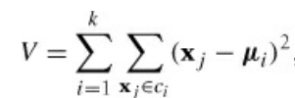
Initialize centroids μi, i = 1 . . . k, randomly or with some guess.
2. Assign each data point to the class ci of its nearest centroid.
3. Update the centroids as the average of all data points assigned to that class.
4. Repeat 2 and 3 until convergence.
K-means tries to minimize the total within-class variance
where xj are the data vectors.

Slide 19
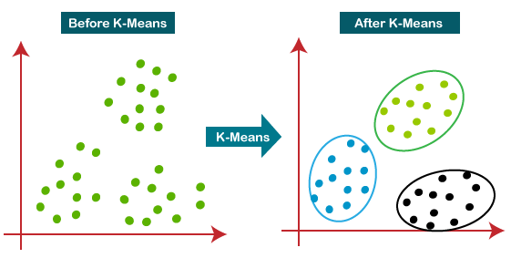

Slide 20
#finding optimal number of clusters using the elbow method
from sklearn.cluster import KMeans
wcss_list= [] #Initializing the list for the values of WCSS
#Using for loop for iterations from 1 to 10.
for i in range(1, 11):
kmeans = KMeans(n_clusters=i, init='kmeans++', random_state= 42)
kmeans.fit(x)
wcss_list.append(kmeans.inertia_)
mtp.plot(range(1, 11), wcss_list)
mtp.title('The Elobw Method Graph')
mtp.xlabel('Number of clusters(k)')
mtp.ylabel('wcss_list')
mtp.show()

Slide 21
WCSS stands for Within Cluster Sum of Squares
WCSS= ∑Pi in Cluster1 distance(Pi C1)2 +
∑Pi in Cluster2 distance(Pi C2)2+
∑Pi in CLuster3 distance(Pi C3)2
where
∑_{Pi in Cluster1} distance(P_{i} C₁)²: It is the sum of the square of the distances between each data point and its centroid within a cluster1 and the same for the other two terms.

Slide 22
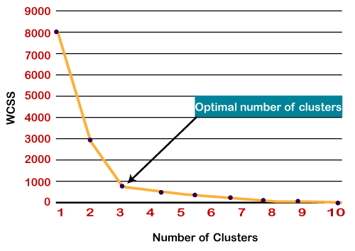

Slide 23
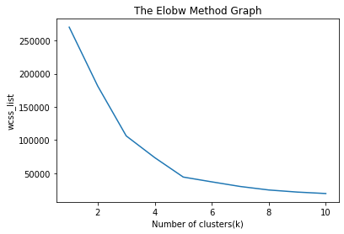

Slide 24
Hierarchical Clustering
Hierarchical clustering (or agglomerative clustering) is another simple but powerful clustering algorithm.
The idea is to build a similarity tree based on pairwise distances.
The algorithm starts with grouping the two closest objects and creates an “average” node in a tree with the two objects as children.
Then the next closest pair is found among the remaining objects but then also including any average nodes, and so on.
At each node, the distance between the two children is also stored.
Clusters can then be extracted by traversing this tree and stopping at nodes with distance smaller than some threshold that then determines the cluster size

Slide 25
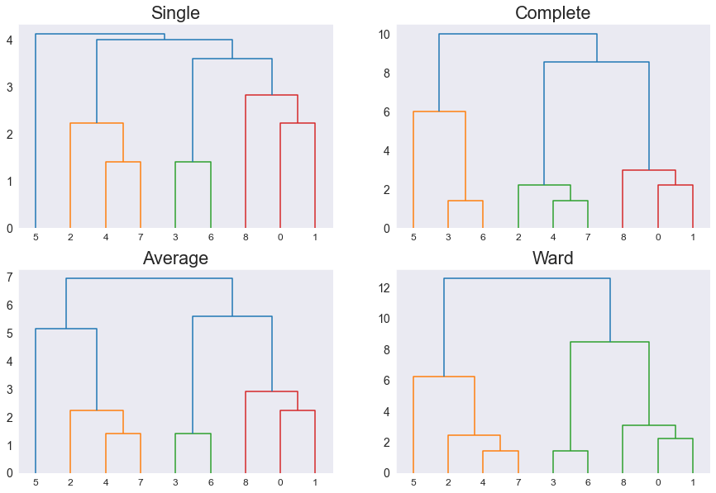

Slide 26
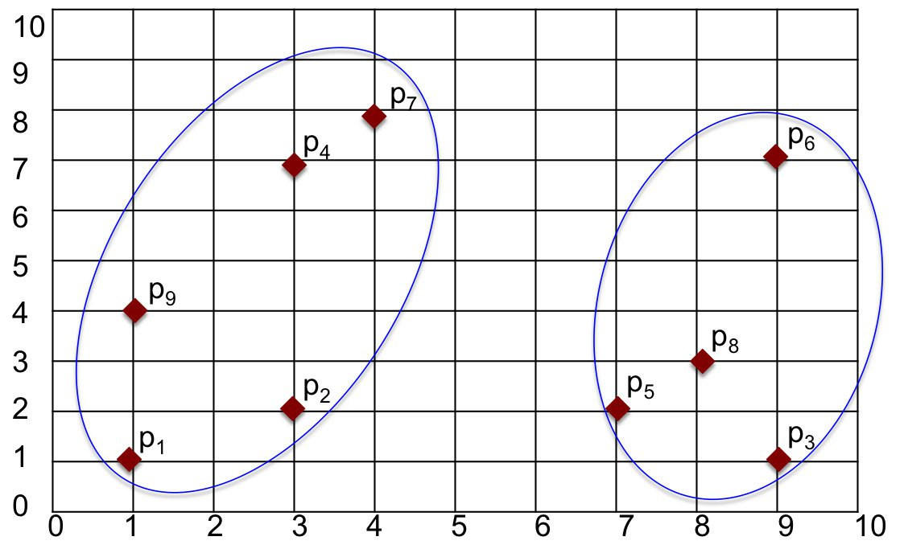
Figure : Two clusters

Slide 27
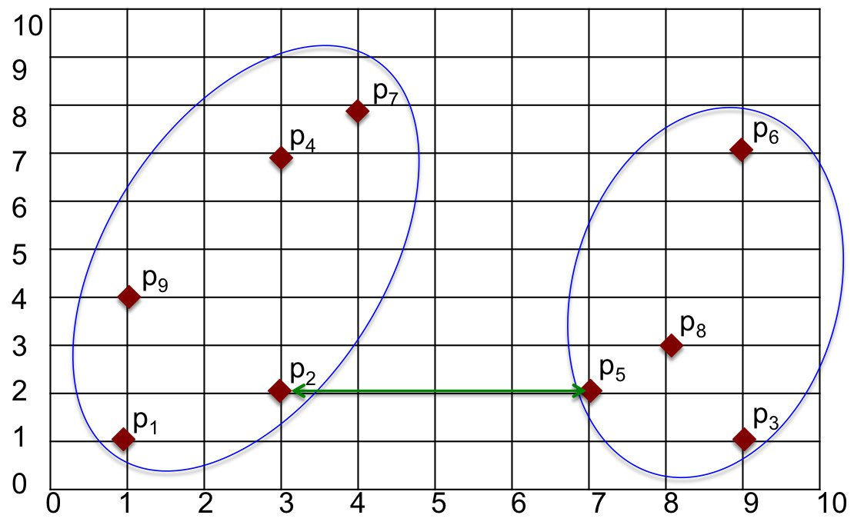
Min (Single) Linkage

Slide 28
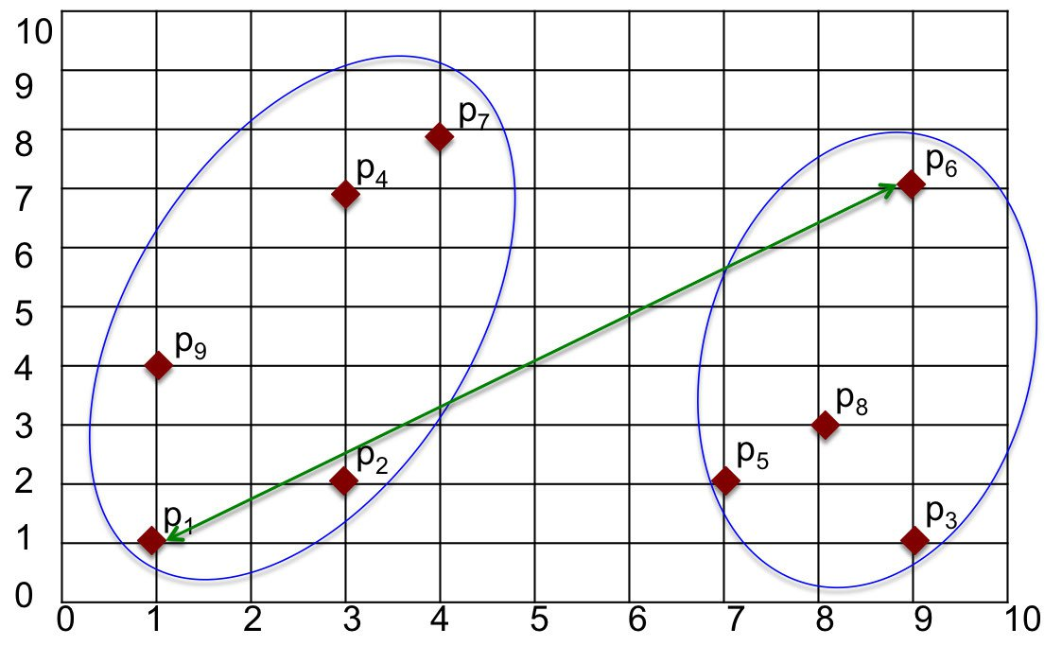
Max (Complete) Linkage

Slide 29
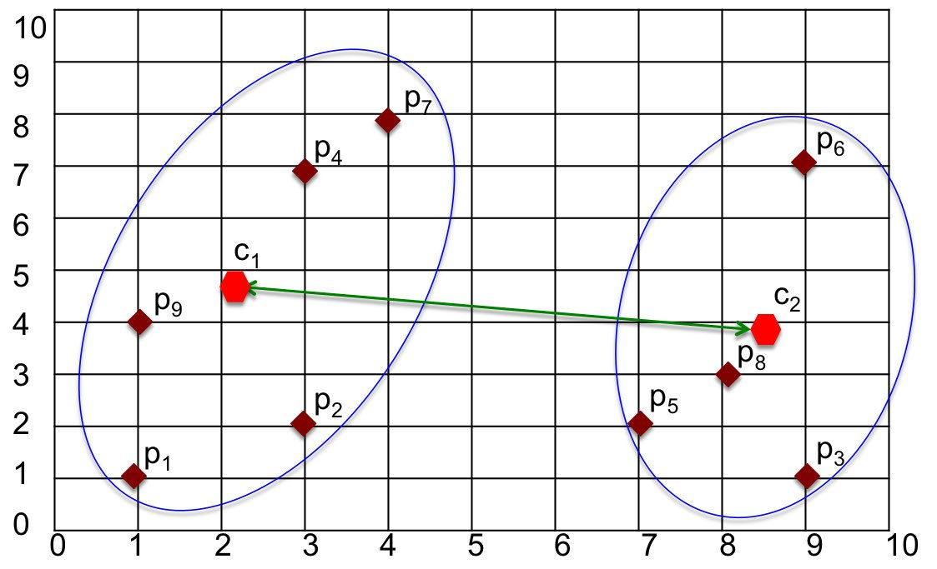
Centroid Linkage

Slide 30
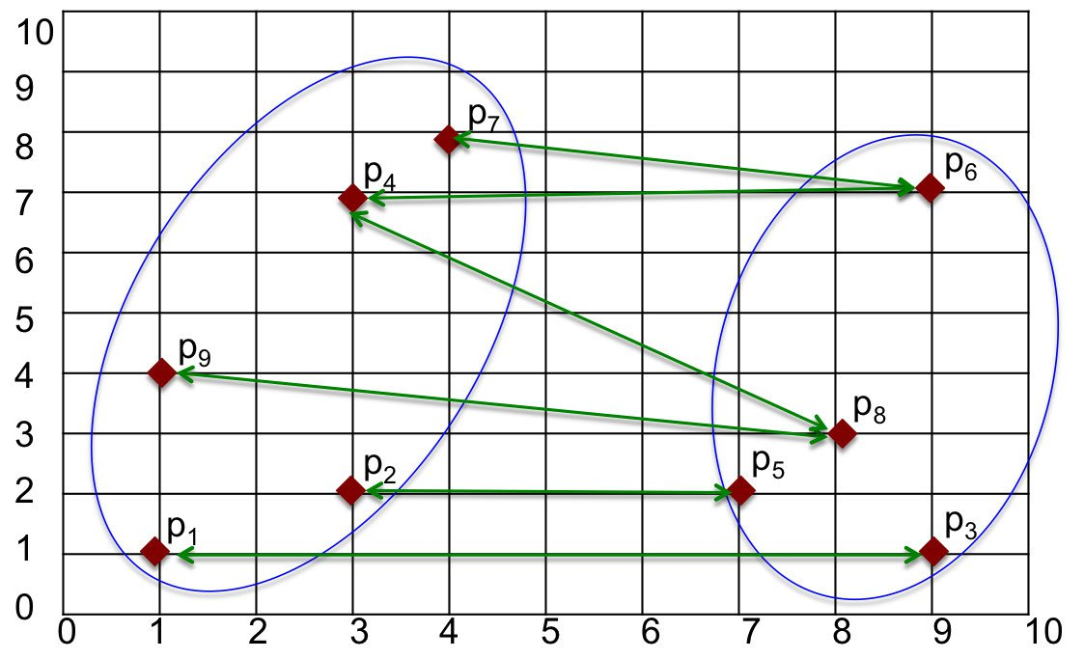
Average Linkage

Slide 31
import numpy as np
import matplotlib.pyplot as plt
import seaborn as sns
sns.set_style('dark')
Next, we'll define a small sample data set:
X1 = np.array([[1,1], [3,2], [9,1], [3,7], [7,2],[9,7], [4,8], [8,3],[1,4]])

Slide 32
Let's graph this data set as a scatter plot:
plt.figure(figsize=(6, 6))
plt.scatter(X1[:,0], X1[:,1], c='r')
# Create numbered labels for each point
for i in range(X1.shape[0]):
plt.annotate(str(i), xy=(X1[i,0], X1[i,1]), xytext=(3, 3), textcoords='offset points')
plt.xlabel('x coordinate')
plt.ylabel('y coordinate')
plt.title('Scatter Plot of the data')
plt.xlim([0,10]), plt.ylim([0,10])
plt.xticks(range(10)), plt.yticks(range(10))
plt.grid()
plt.show()

Slide 33
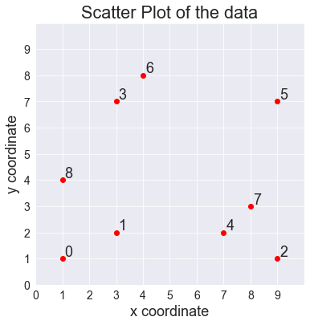

Slide 34
Spectral Clustering
In practice Spectral Clustering is very useful when the structure of the individual clusters is highly non-convex, or more generally when a measure of the center and spread of the cluster is not a suitable description of the complete cluster, such as when clusters are nested circles on the 2D plane.

Slide 35
Algorithm
The algorithm can be broken down into 4 basic steps.
1.Construct a similarity graph
2.Determine the Adjacency matrix W, Degree matrix D and the Laplacian matrix L
3.Compute the eigenvectors of the matrix L
4.Using the second smallest eigenvector as input, train a k-means model and use it to classify the data

Slide 36
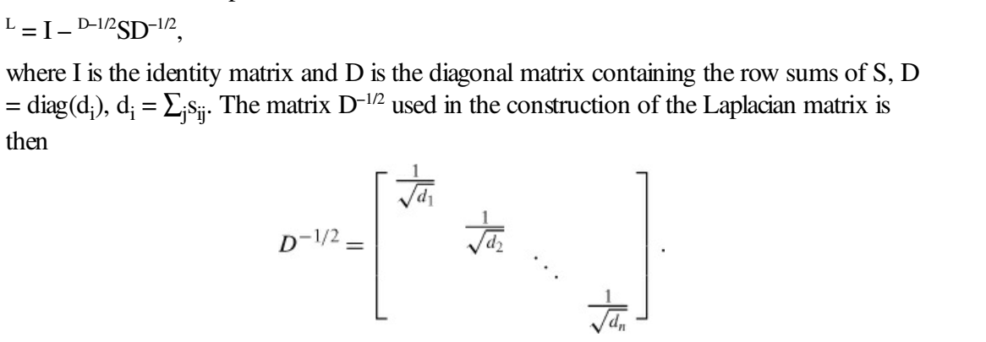
Given a n × n similarity matrix S with similarity scores sij, we can create a matrix, called the Laplacian matrix

Slide 37
import numpy as np float_formatter = lambda x: "%.3f" % x np.set_printoptions(formatter={'float_kind':float_formatter}) from sklearn.datasets.samples_generator import make_circles from sklearn.cluster import SpectralClustering, KMeans from sklearn.metrics import pairwise_distances from matplotlib import pyplot as plt import networkx as nx import seaborn as sns sns.set()

